Slide 1

Michaele Schreyer
Chair of the Supervisory Board of the Heinrich Böll Foundation
Monday, December 5th
11.30 am - 1.30 pm
Diakonia Center,
Diakonia Avenue Durban 4001

Slide 2

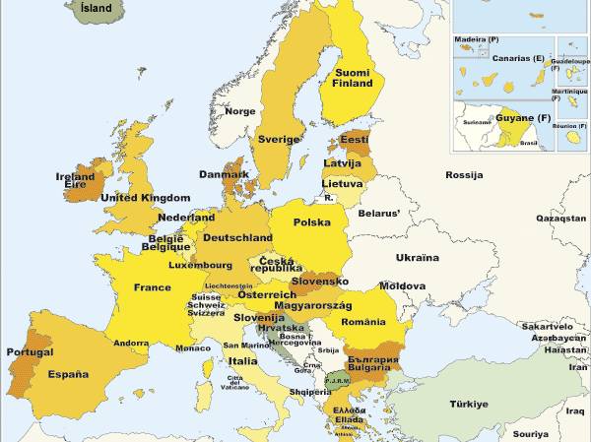
27 Member States
500 Million People

Slide 3
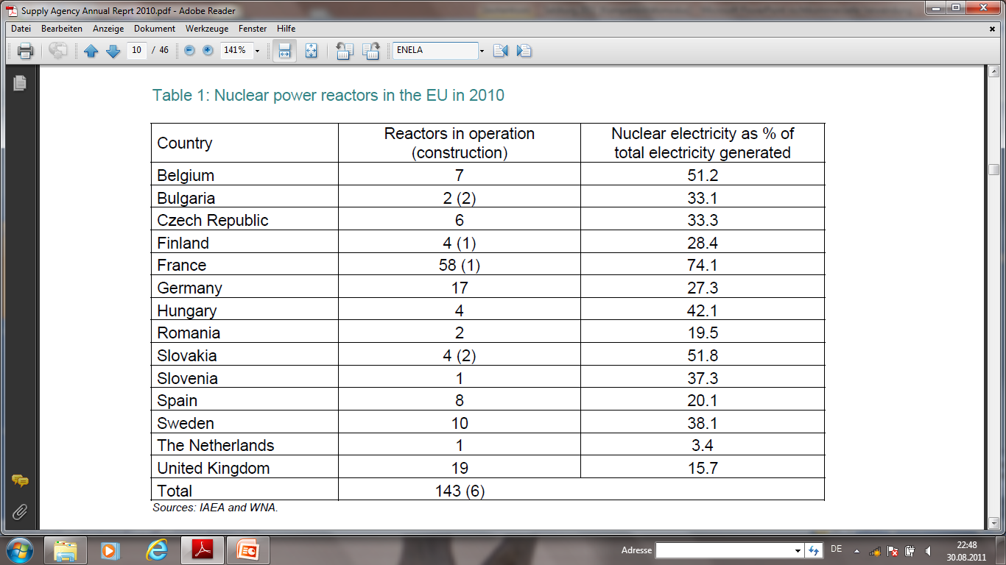
Nuclear Power in the EU
Share of Nuclear in power generation
27,8 % (year: 2009)
2010
143 reactors in operation
14 Member States have reactors in operation
13 MS have no reactors in operation

Slide 4
Share of Nuclear in National Electricity Generation 2009 (%)

Slide 6
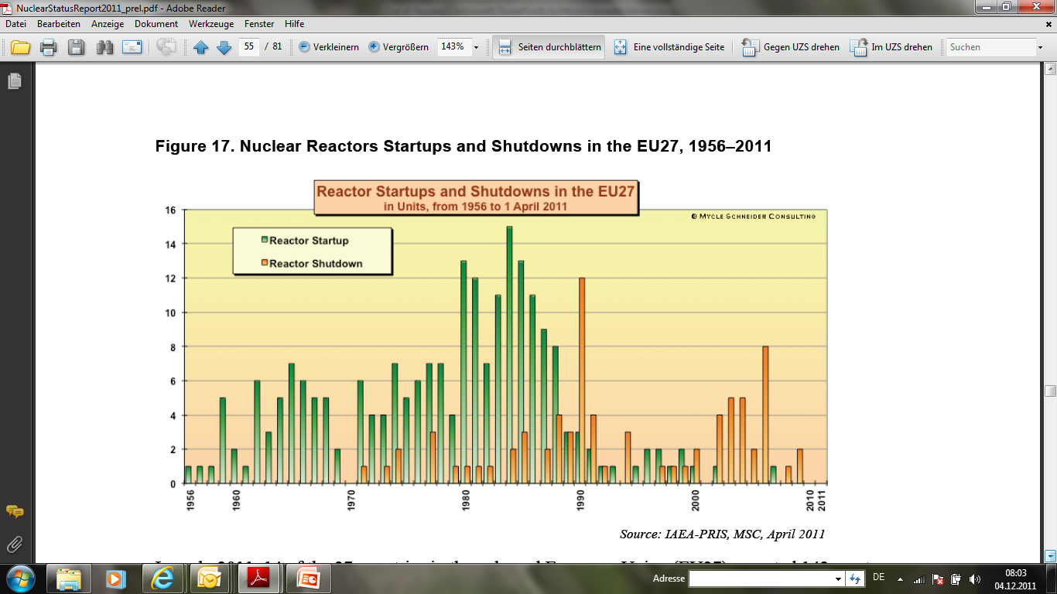
The World Nuclear Industry Status Report 2010–2011 By
Mycle Schneider , Antony Froggatt, Steve Thomas

Slide 7
Changes over time regarding the use of nuclear energy in the EU
Share of nuclear in electricity generation and number of operating reactors is decreasing (1989: 177 units / 2010: 143 units / 2011: 135 units
Nearly half of the Member States have no operating NPP
The consensus on the benefits of nuclear power of the founding period of EURATOM no longer exists
There is the alternative of using renewable energy

Slide 8
The 20 : 20: 20 EU Energy Package
Reducing greenhouse gas emissions by 20%
Improving energy efficiency by 20%
Increasing the share of renewables in final
energy consumption at least to 20%
All by 2020

Slide 9
Share of RES in final energy consumption
Binding national targets

Slide 10
Share of renewable energies in gross electrical consumption in European Union countries in 2009 (in %)
Source : Eurostat

Slide 11
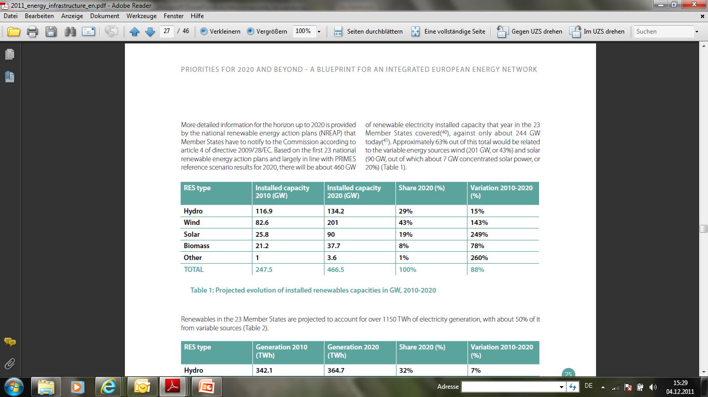
Projected evolution of installed renewables capacities in GW, 2010-2020
Source: European Commission: Priorities for 2020 and beyond ─ A Blueprint for
an integrated European energy network, p. 25

Slide 12
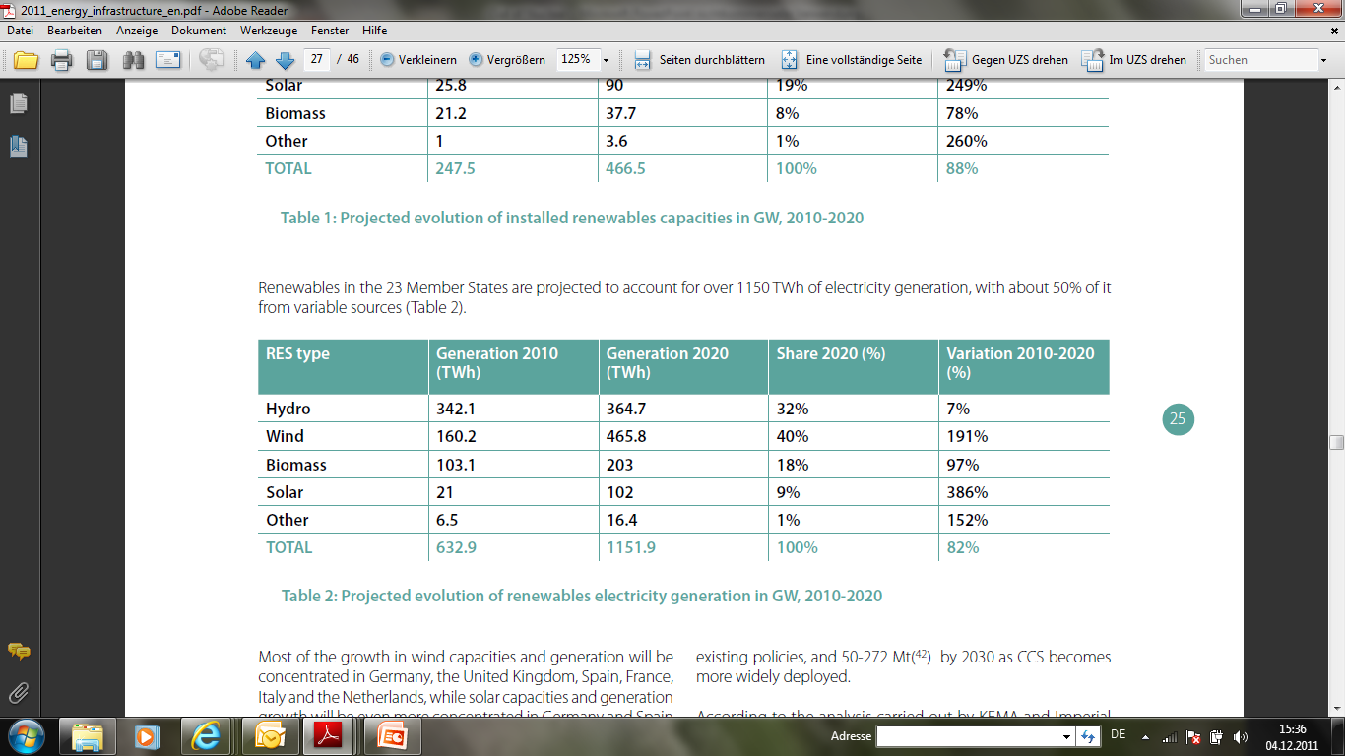
Projected evolution of renewables electricity generation in GW, 2010-2020
Source: European Commission: Priorities for 2020 and beyond ─ A Blueprint for
an integrated European energy network, p. 25

Slide 13
Based on Member States' plans, renewable energy should constitute
37%
of EU's
electricity mix by 2020.

Slide 14

100% green power!
Utopia or a realistic vision?

Slide 15
Europe’s economic potential for electricity generated from renewable energy sources
According to the German Aerospace Center (study of 2006) the EU, together with Norway, Iceland, Switzerland, the West Balkan States, and Turkey have an economic potential for RES-E of around 5780 TWh/a.
The electricity consumption of these countries was about 3800 TWh/a.

Slide 16
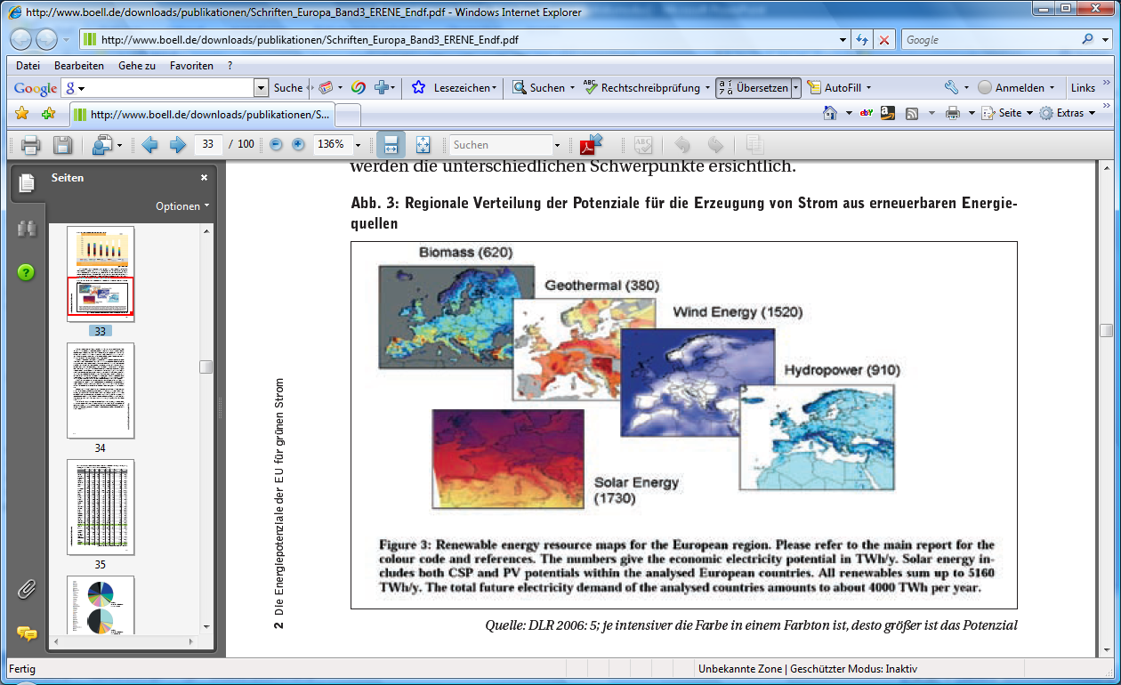
Regional distribution of the potential to generate electricity from renewable sources

Slide 17
Europe’s competitive potential of wind energy
According to the European Environment Agency the EU, Norway, Switzerland and Turkey together have a competitive wind power potential for 2020 (2030)
Onshore of 9600 ( 27 000)TWh
Offshore of 2600 ( 3 000) TWh
The current electricity consumption of these countries is about 3550 TWh/a.

Slide 18
Europe’s economic potential for electricity generated from renewable energy sources
According to a recent study of the German Aerospace Center (commissioned by the German Advisory Council on the Environment) Europe (without Russia) together with North- African countries have an economic potential for RES-E of around 105 000 TWh/a.
The use of 2 % of this potential would be sufficient to cover the electricity demand of the region

Slide 19

Let‘s put the vision into reality!
http://www.erene.org/

