Slide 1
Japan’s energy policy after 3.11 nuclear accident
Kimiko Hirata
Kiko Network
5 Dec. 2011

Slide 2
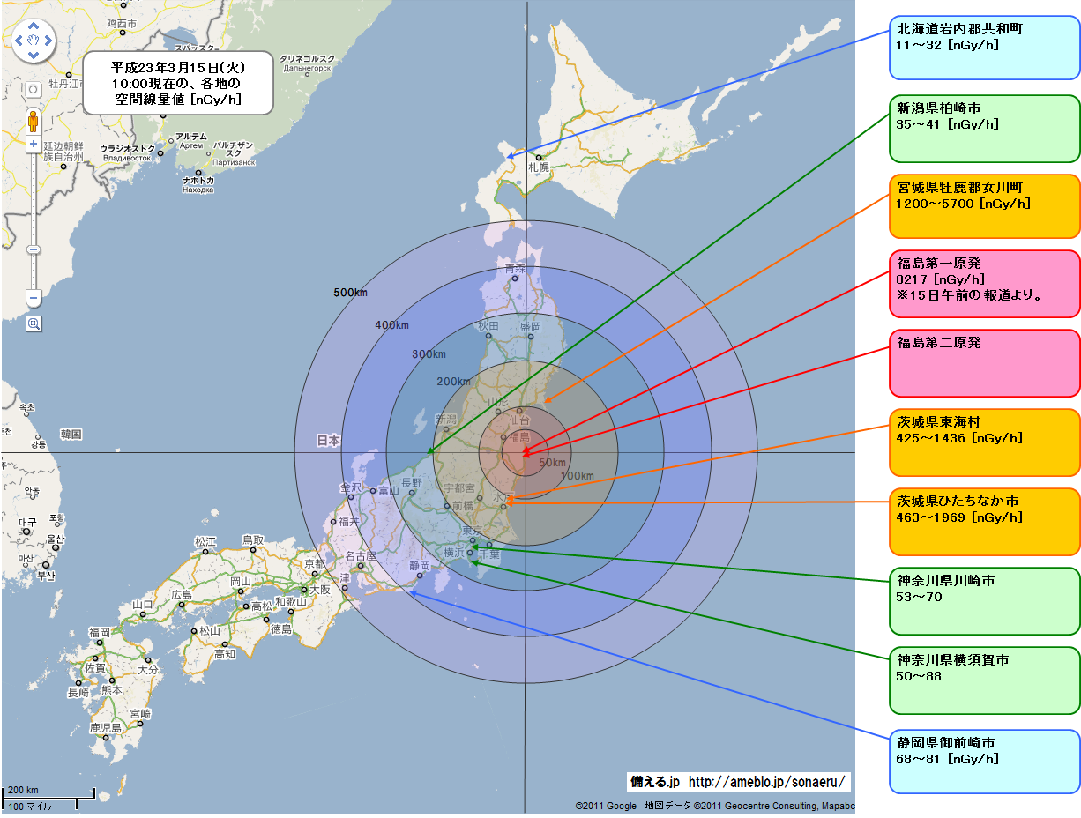
Notes:
Japan is a small country. Distance from Fukushima to Tokyo is less than 300 km, and even Osaka is within 500 km.

Slide 3
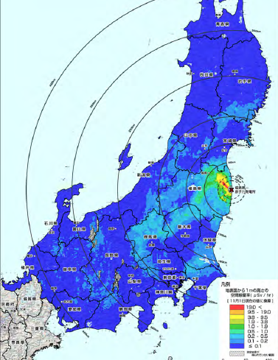
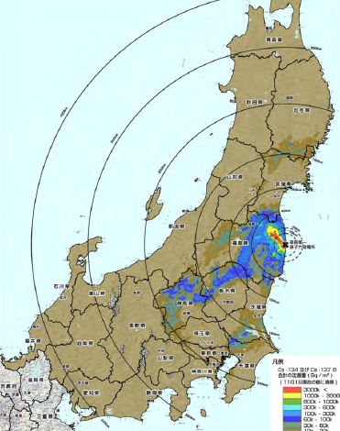
Notes:
Radioactive materials has been released widely.
Large amounts of them have also been released into the Pacific Ocean.
But Information about the risk of radiation exposure was limited, and the government kept saying it’s not immediately dangerous.
The government and Tokyo Electric power company (TEPCO) have been criticized for poor communication with the public.
After 6 month later, the Government has guradually releaesd contamination map based on assessment by plane. Left map shows spread of radioactive materials detected in the atmosphere and right map is a cesium contamination in the soil.
You can see that how widely radiation has spread.

Slide 4
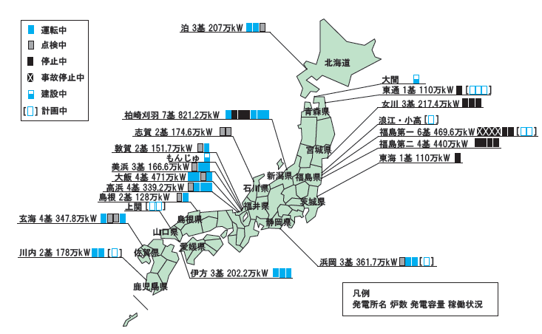
Notes:
We have had 54 nuclear power plants in 17 sites. Due to accident as well as regular checking, 44 out of them stopp currently and only 10 reactors are operating.

Slide 5
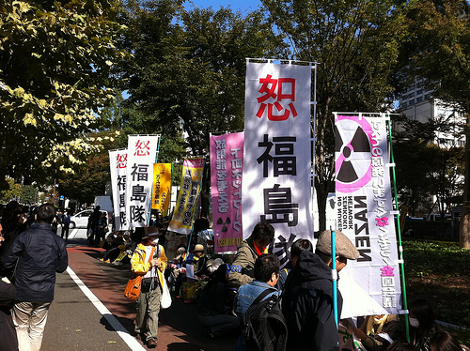
Fukushima Nuclear Accident
Large Scale damage
  Damage to living & economy
  Impact to agriculture, fishery, and industry
  Food Contamination
Difficulty to recover
  30 years to decommissioning
  cleanup
Civil society change
  People’s wake-up
  70% oppose nuclear
Fukushima Women’s Demonstration（27 Oct. 2011）
Notes:
These cause serious damage on living and economy in large scale .
The area surrounding plants remain uninhabitable for decades due to high radiation. High level contamination has been detected from food, water, and milk, and industrial products, too.
It is said that it takes at least 30 years to decommissioning nuclear reactors. And land cleanup is overwhelming task. We know perfect cleanup is impossible.
Day after day, we experience how difficult to manage the released radioactive materials and how damaging the accident was.

Slide 6
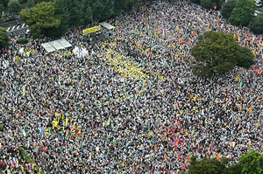
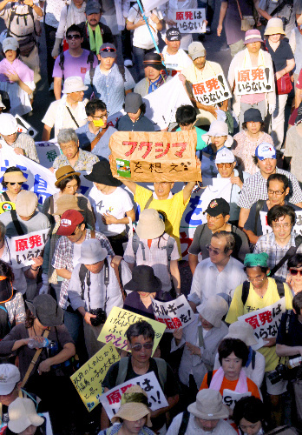
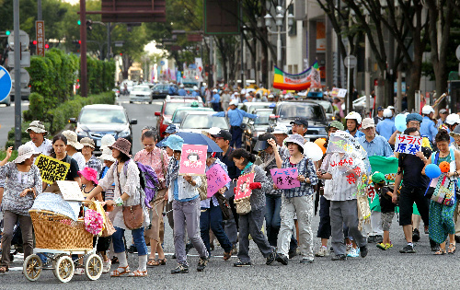
Notes:
One thing which I think is very new is the public reaction. We see various demonstration and people speak out against nuclear.

Slide 7
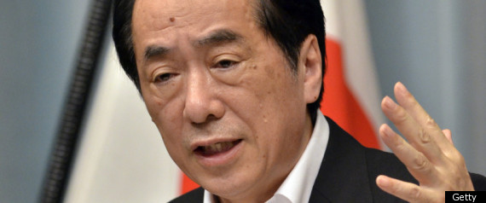
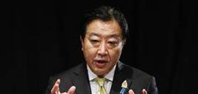
Energy Policy debate
Former PM Kan’s initiative
  First leader to aim nuclear free society
  "We should gradually and systematically reduce reliance on nuclear power and eventually aim at a society where people can live without nuclear power plants." (13 July)
  Feed- in –Tariff (FIT) passed, start in July 2012
Review process started under PM Noda
1. Avoid energy shortfalls and price rises
2. Draw up new energy scenario
3. Review of nuclear power policies
  Discussion points
1.Energy saving
2.Renewable energies
3.Resources and fuel
4.Nuclear energy
5.Electric power system
6.Energy and environment industry
New policy will be decided next summer 2012

Slide 8
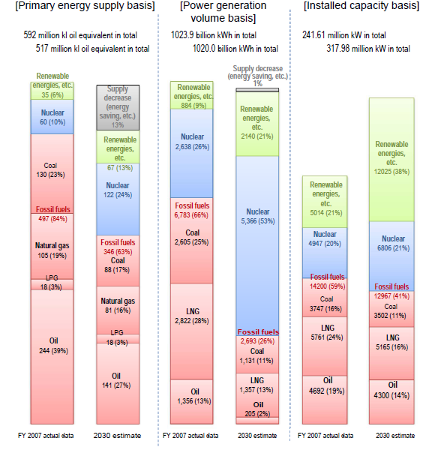
Energy Policy debate
Present Energy plan

Slide 9
Energy Policy Debate
Japan has increased Coal consumption for electricity
Copyright © 気候ネットワーク All Rights Reserved.

Slide 10
1.Near-term electricity supply & demand
Nuclear operation might be zero in September 2012
  Local government doesn’t allow to re-operate reactors

Slide 11
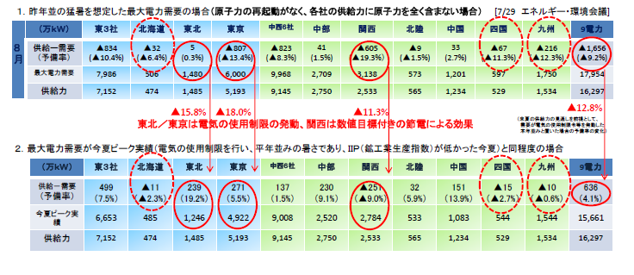
1.Near-term electricity supply and demand
Government estimates
10% of shortage expected next summer, but??

Slide 12
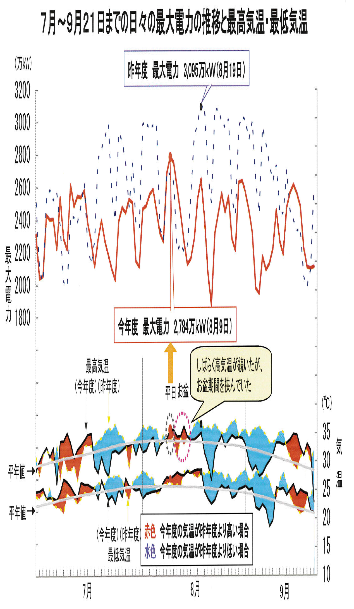
1.Near-term electricity supply and demand
Demand side management to avoid peak time
出典）関西電力「今夏の需給状況について」2011年9月21日

Slide 13
1.Near-term electricity supply and demand
Regional connection
交流
直流
単位：万キロワット
Hokkaido
650
Connection
60
130
Hokuriku
811
Tohoku
1,739
Okinawa
192
30
120
500
278
400
250
120
Chugoku
1,220
Kansai
3,486
Chubu
3,247
Tokyo
6,183
30
270
120
Kyushu
1,941
120
Shikoku
685
60Hz
周波数
変換装置
50Hz
140
Notes:
Although power generation is regionally monopolized by 10 power companies, we could seek strengthen connection, to avoid peak power shortage.

Slide 14
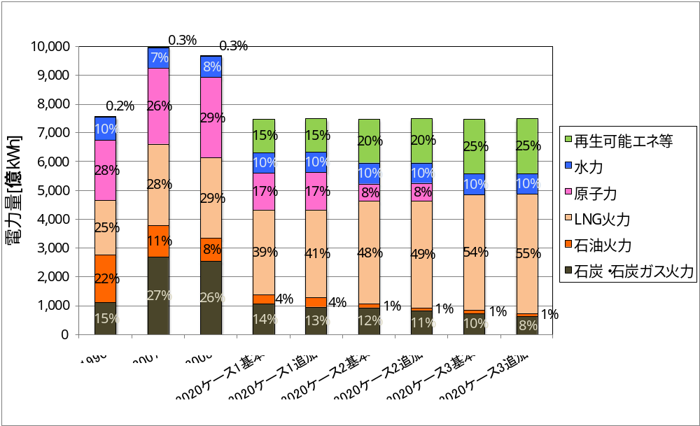
2．Mid term energy plan
Kiko Network’s 2020 scenario
Case 1：25% of renewables (10% large hydro)
Case 2：30% of renewables (10% large hydro)
Case 3：35% of renewables (10% large hydro)
Copyright © 気候ネットワーク All Rights Reserved.
Notes:
We have 2020 scenario and assessed whether japan could meet 25% reduction target while reducing dependence nuclear and fossil fuel.
And we showed it that it is possible.

Slide 15
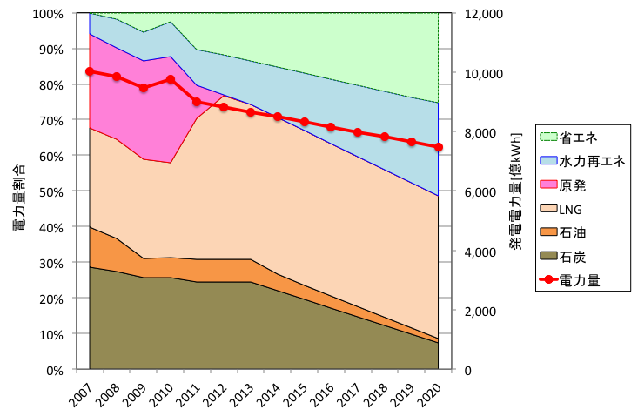
2. Mid-term Energy policy
Possible to realize nuclear free society
Energy conservation
Renewables
Nuclear
Electricity generation
LNG
Oil
Coal
Notes:
The share of power generation looks like this.

Slide 16
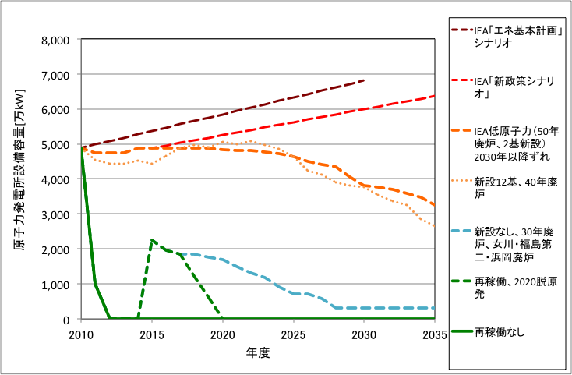
2. Mid-term Energy policy
Divided views – timeframe, level of dependence
IEA
IEA new policy
IEA low nuclear
12 new plant + 40 yr lifetime
No new plant + 30 yr lifetime
Re-operate +
2020 phase out
Immediate phase out
Notes:
However, there’s division for future energy scenario.
Last month, IEA executive Director came over to Japan and made presentation based on IEA energy scenario.
The 3 scenario shows top 3 lines are scenario presented by him. Even low nuclear sceanrio, it shows slight increase of nuclear capacity, but he said that it is very costly because it requires significant increase of fossil fuel.
I have to say that this doesn’t reflect the reality. The scenario shows to reoperate even Fukushima dai2 reactors as well as stopped reactors by PM Kan. Reality is green line. Probability to be zero nuclear operation is quite realistic, and re-operation is very politicized issue.
At the

Slide 17
3. Climate policy implication
Climate debate suspended
  Climate bill – still on the table
    Target : -25% by 2020, -80% in 2050
    Policies and measures: Cap and Trade / Carbon tax
    Feed-in-tariff (passed as separate law)
Climate policy review?
  Depending on the discussion of energy policy review, climate policy may be reviewed.
  25% reduction target may be reconsidered.
2012 Big important year

